Slide 1
Chapter 6
How to use CSS for page layout

Slide 2
Objectives
Applied
Given an HTML document, create a CSS style sheet that uses floating to implement a fixed or fluid page layout in two- or three-column format with both header and footer.
Knowledge
Describe the use of floating for page layout.
Describe the use of the clear property in a CSS rule set.
Distinguish between fixed and fluid page layout.
Describe the use of the CSS3 feature for text columns.
Describe the use of absolute, relative, and fixed positioning.

Slide 3
The HTML for a web page with a sidebar
<body>
<aside>
<p>The luncheon starts 15 minutes after the lecture ends</p>
</aside>
<main>
<p>Welcome to San Joaquin Valley Town Hall. We have some fascinating speakers for you this season!</p>
</main>
<footer>
<p>Please call today at (559) 555-1212 to get your tickets!</p>
</footer>
</body>

Slide 4
The CSS for floating the sidebar
body { width: 500px; }
main, aside, footer {
margin: 0;
padding: 0px 20px; }
aside {
margin: 0 20px 10px;
width: 150px;
float: right;
border: 1px solid black; }
footer { clear: both; }

Slide 5
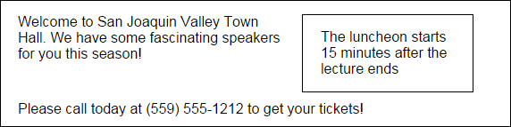
The web page with the side bar in a browser

Slide 6
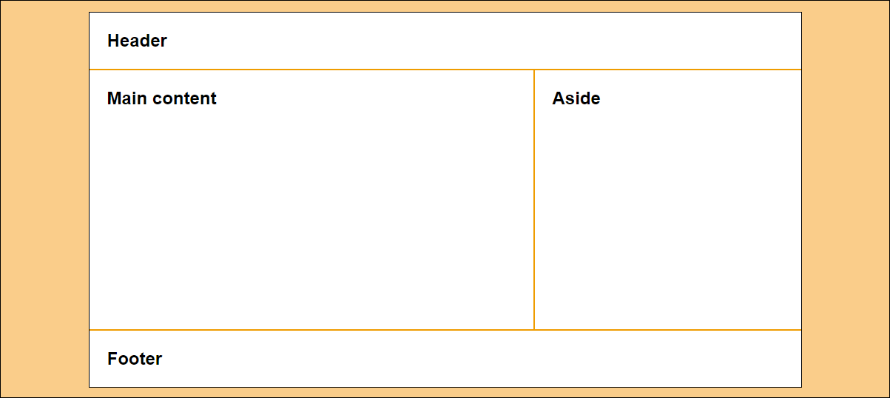
A 2-column web page with fixed-width columns

Slide 7
The HTML for the 2-column, fixed-width page
<body>
<header>
<h2>Header</h2>
</header>
<main>
<h2>Main content</h2>
</main>
<aside>
<h2>Aside</h2>
</aside>
<footer>
<h2>Footer</h2>
</footer>
</body>

Slide 8
The CSS for the 2-column, fixed-width page
* { margin: 0; padding: 0; }
body {
width: 962px;
background-color: white;
margin: 15px auto;
border: 1px solid black; }
h2 { padding: 1em; }
header { border-bottom: 2px solid #ef9c00; }
main {
height: 350px; /* to give the sidebar some height for its border */
width: 600px;
float: left;
border-right: 2px solid #ef9c00; }
aside {
width: 360px;
float: right; }
footer {
clear: both;
border-top: 2px solid #ef9c00; }

Slide 9
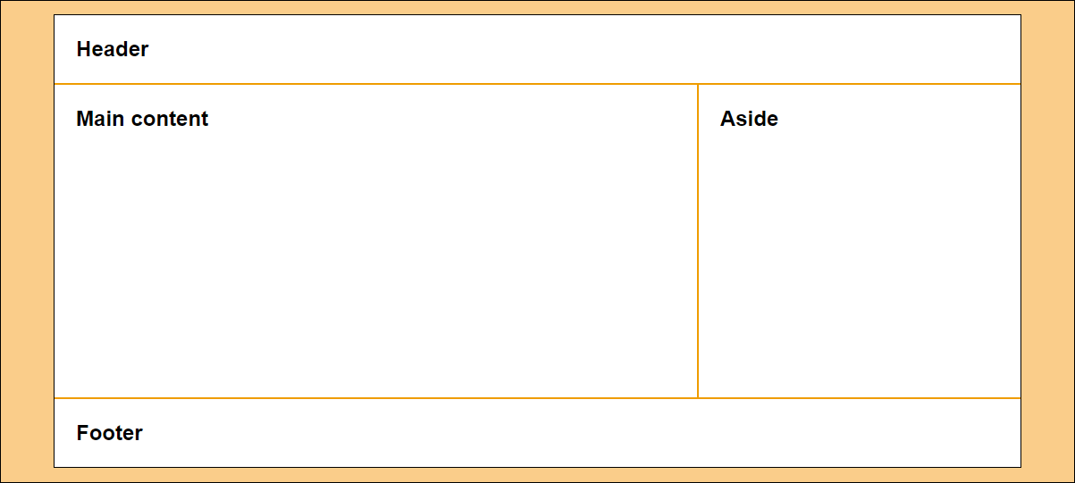
A 2-column page with fluid column widths

Slide 10
The CSS for the 2-column, fluid page
body {
width: 90%;
background-color: white;
margin: 15px auto;
border: 1px solid black; }
main {
width: 66%;
height: 350px; /* to give the main content some height */
border-right: 2px solid #ef9c00;
float: left; }
aside {
width: 33%;
float: right; }

Slide 11
The CSS when the aside is fixed and the section is fluid
body {
width: 90%;
background-color: white;
margin: 15px auto;
border: 1px solid black; }
main {
float: left; }
aside {
height: 350px; /* to give the aside some height */
width: 360px;
border-left: 2px solid #ef9c00;
float: right; }

Slide 12
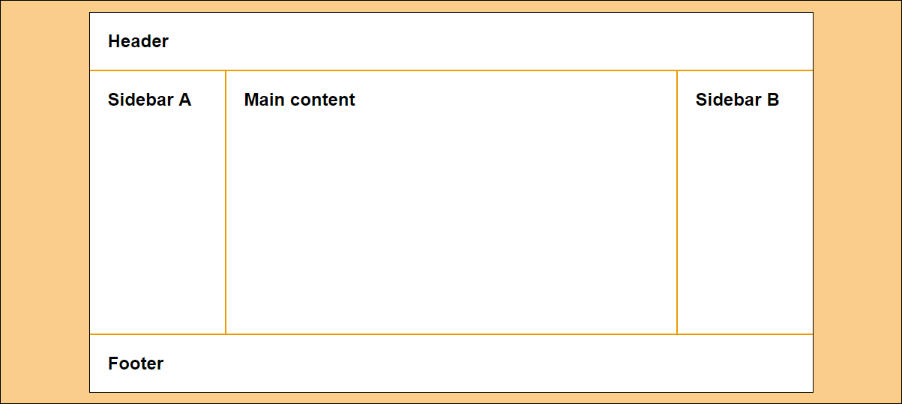
A 3-column page with fixed-width columns

Slide 13
The HTML for the 3-column page
<body>
<header>
<h2>Header</h2>
</header>
<aside id="sidebarA">
<h2>Sidebar A</h2>
</aside>
<main>
<h2>Main content</h2>
</main>
<aside id="sidebarB">
<h2>Sidebar B</h2>
</aside>
<footer>
<h2>Footer</h2>
</footer>
</body>

Slide 14
The CSS for the 3-column, fixed-width page
body {
width: 964px;
background-color: white;
margin: 15px auto;
border: 1px solid black; }
#sidebarA {
width: 180px;
height: 350px; /* to give the sidebar some height for its border */
float: left;
border-right: 2px solid #ef9c00; }
main {
width: 600px;
float: left; }
#sidebarB {
width: 180px;
height: 350px; /* to give the sidebar some height for its border */
float: right;
border-left: 2px solid #ef9c00; }

Slide 15
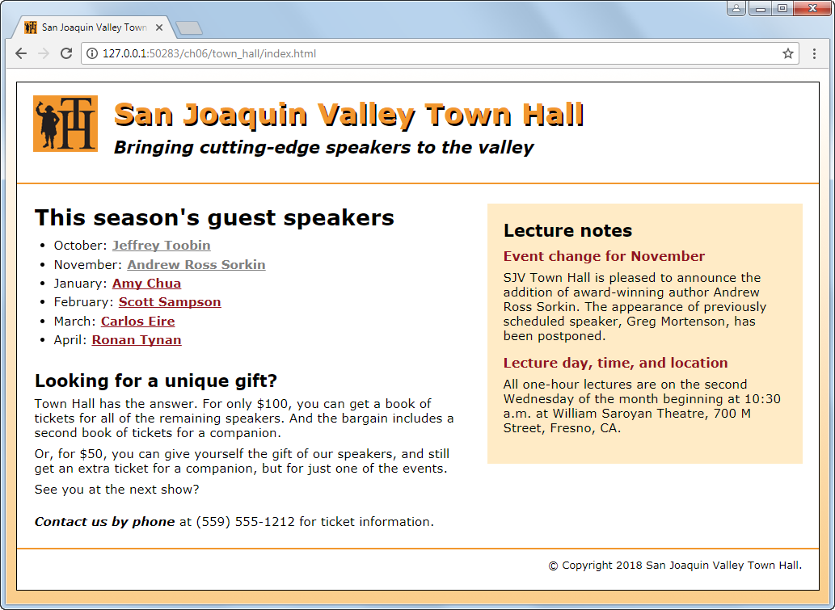
A home page with a sidebar floated to the right

Slide 16
The HTML for the home page (part 1)
<head>
...
<link rel="stylesheet" href="styles/normalize.css">
<link rel="stylesheet" href="styles/main.css">
</head>
<body>
<header>
<img src="images/logo.jpg" alt="Town Hall Logo" width="80">
<h2>San Joaquin Valley Town Hall</h2>
<h3>Bringing cutting-edge speakers to the valley</h3>
</header>
<main>
<aside>...</aside>
<section>...</section>
</main>

Slide 17
The HTML for the home page (part 2)
<footer>
<p>&copy; Copyright 2018 San Joaquin Valley Town Hall.</p>
</footer>
</body>
</html>

Slide 18
The CSS for the home page (part 1)
body {
font-family: Verdana, Arial, Helvetica, sans-serif;
font-size: 100%;
width: 990px;
background-color: white;
margin: 15px auto;
padding: 15px 0;
border: 1px solid black; }
section, aside, h1, h2, h3, p {
margin: 0;
padding: 0; }
section, aside {
margin-top: 1.5em;
margin-bottom: 1em; }

Slide 19
The CSS for the home page (part 2)
section {
width: 535px;
float: right;
margin-left: 20px;
padding-right: 25px;}
aside {
width: 350px;
float: right;
padding: 20px;
background-color: #ffebc6;
margin-right: 20px; }
footer {
clear: both;
border-top: 2px solid #f2972e;
padding-top: .7em; }

Slide 20
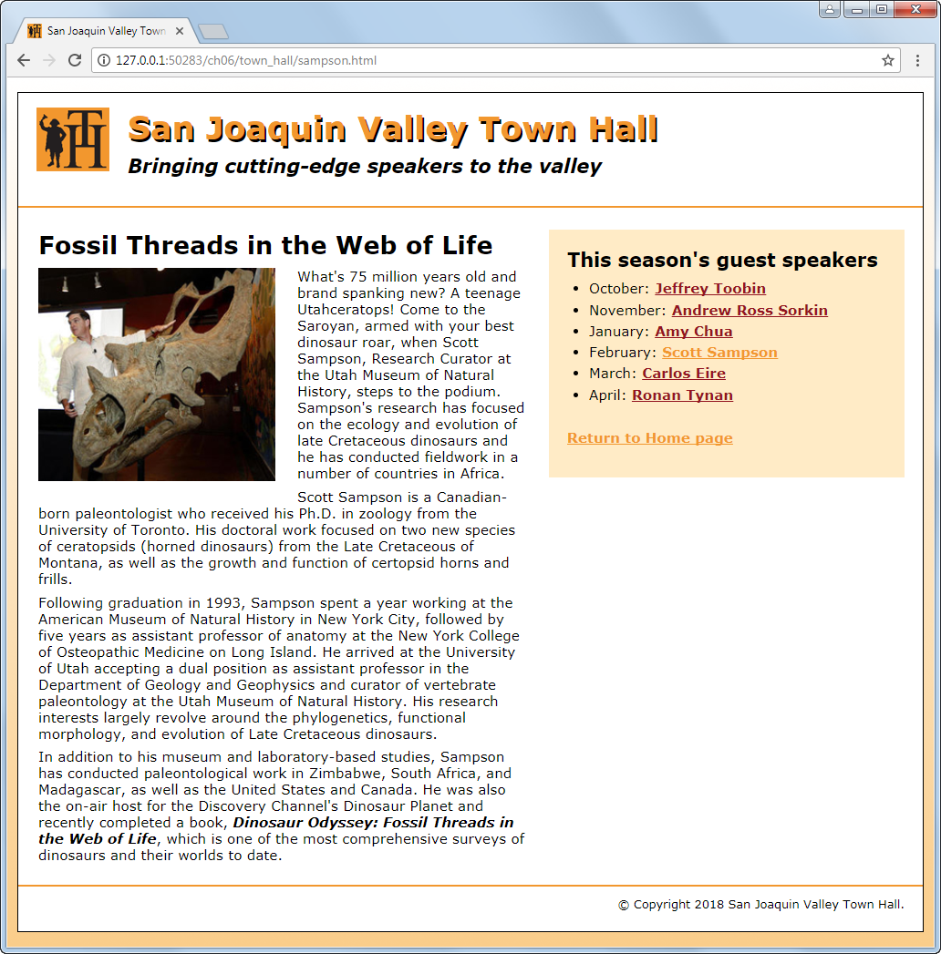
A speaker page with a sidebar on the right

Slide 21
The HTML for the speaker page
<head>
...
<link rel="stylesheet" href="styles/normalize.css">
<link rel="stylesheet" href="styles/speaker.css">
</head>
<body>
<header>...</header>
<main>
<aside>...</aside>
<article>...</article>
</main>
</body>

Slide 22
The CSS for the speaker page
article {
width: 535px;
float: right; }
aside {
width: 350px;
float: right; }
article img {
float: left; }

Slide 23
The primary CSS3 properties for creating text columns
column-count
column-gap
column-rule
3 columns with default-sized gaps
article {
column-count: 3; }
3 columns with 35px gaps and 2px rules between the columns
article {
column-count: 3;
column-column-gap: 35px;
column-rule: 2px solid black; }

Slide 24
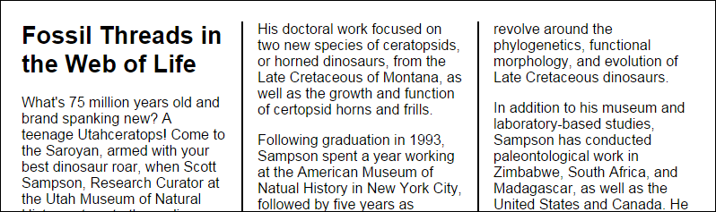
3 columns with 35px gaps and 2px rules in a browser window
Try it out
http://aaronlumsden.com/multicol/

Slide 25
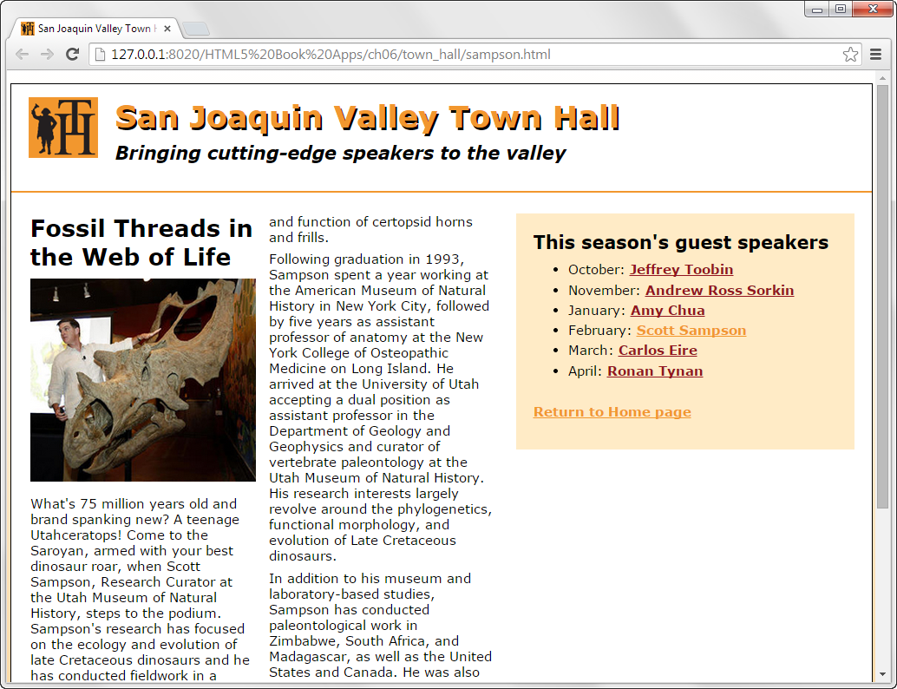
A web page with a two-column article

Slide 26
The CSS for creating the columns
article {
column-count: 2;
}

Slide 27
Properties for positioning elements
position
top, bottom, left, right
z-index
Possible values for the position property
static
absolute
fixed
relative
sticky
More Information
https://www.w3schools.com/css/css_positioning.asp

Slide 28
The HTML for a web page that will use positioning
<body>
<main>
<h1>Our speakers this season</h1>
<ul>
<li>October: <a href="speakers/toobin.html">
Jeffrey Toobin</a></li>
<li>November: <a href="speakers/sorkin.html">
Andrew Ross Sorkin</a></li>
<li>January: <a href="speakers/chua.html">
Amy Chua</a></li>
</ul>
<p>Please contact us for tickets.</p>
</main>
<aside>
<p><a href="raffle.html">Enter to win a free ticket!</a></p>
</aside>
</body>

Slide 29
The CSS for the web page with absolute positioning
body {
position: relative; } /* not needed for fixed positioning */
aside {
width: 80px;
position: absolute; /* change to fixed for fixed positioning */
right: 30px;
top: 50px; }

Slide 30
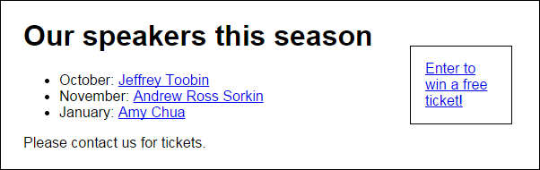
The web page with absolute positioning in a browser

Slide 31
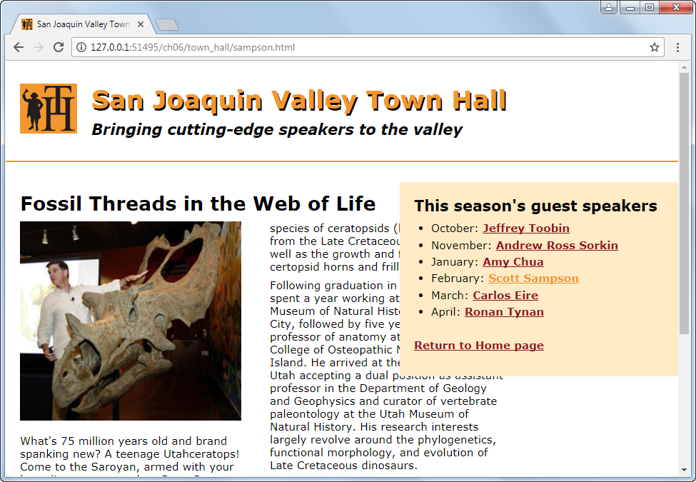
A sidebar that uses fixed positioning

Slide 32
The CSS for the positioned element
aside {
width: 350px;
position: fixed;
right: 0;
top: 170px;
}

Slide 33
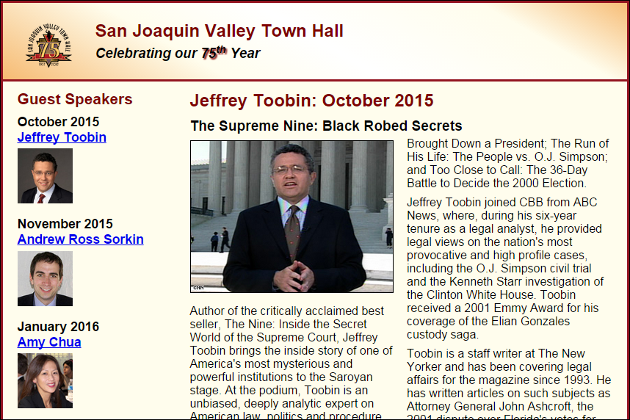
Short 6-1 Use the CSS3 columns feature

Slide 34

Short 6-2 Switch the columns of a page

Slide 35
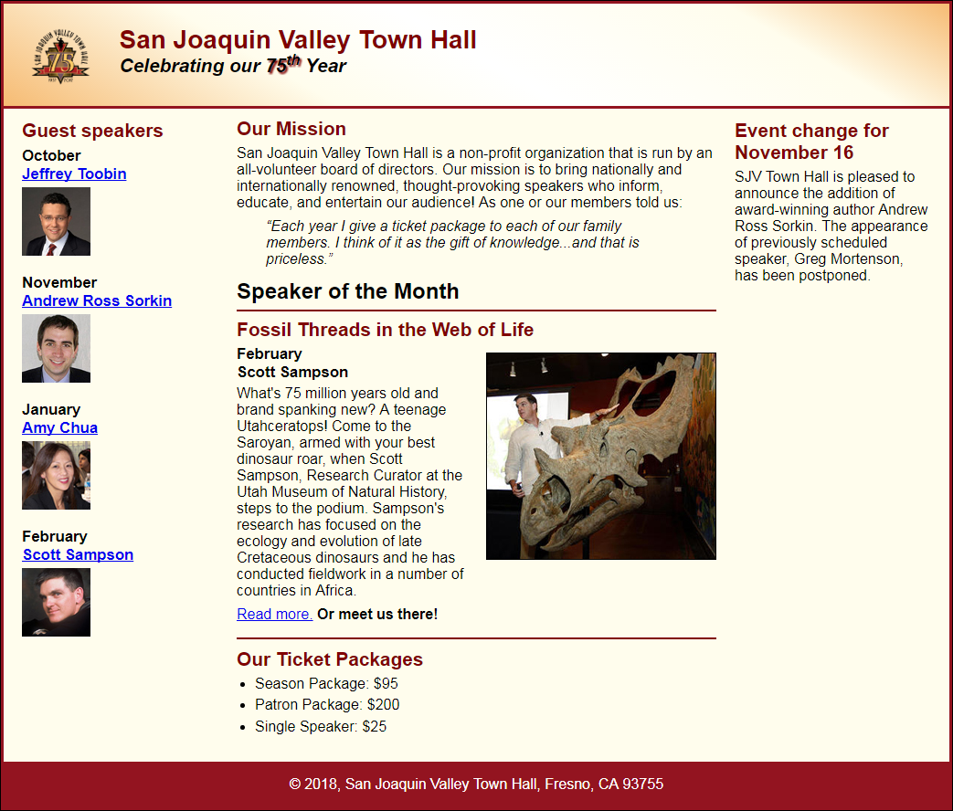
Short 6-3 Add a third column to a page

Slide 36
Objectives
Applied
Given an HTML document, create a CSS style sheet that uses floating to implement a fixed or fluid page layout in two- or three-column format with both header and footer.
Knowledge
Describe the use of floating for page layout.
Describe the use of the clear property in a CSS rule set.
Distinguish between fixed and fluid page layout.
Describe the use of the CSS3 feature for text columns.
Describe the use of absolute, relative, and fixed positioning.

Slide 37
Assignments
Reading assignments on Perusall
Homework and Labs on InsideRanken

